Slide 1
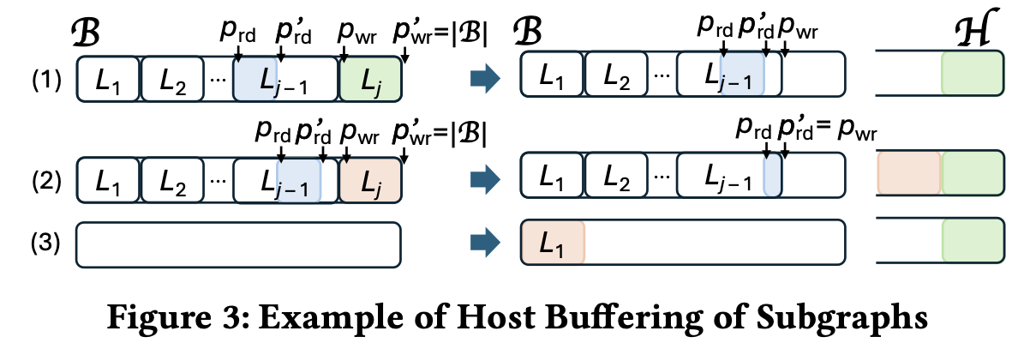
Managed Memory Spill Buffer
Too slow to read/write to managed memory buffer.
Example:
wikipedia_link_ru
total run time: 85.2 sec
host buffer read/write: 8.3 sec
Brd
H

Slide 2
Host Resident Buffer
Create with new
After returning from kernel, copy data to/from host buffer
Bulk copy data instead of copying each subgraph
Brd
H
wikipedia_link_ru
total run time: 76.6 sec
host buffer read/write: 1.3 sec

Slide 3
Host Resident Buffer – Downside
Managed Memory case:
spill to H
Bwr
H
90% filled → press brake pedal
Host Resident:
Bwr
H
spill not possible
90% filled → press brake pedal
wikipedia_link_fr is facing this situation. How to address it??

Slide 4
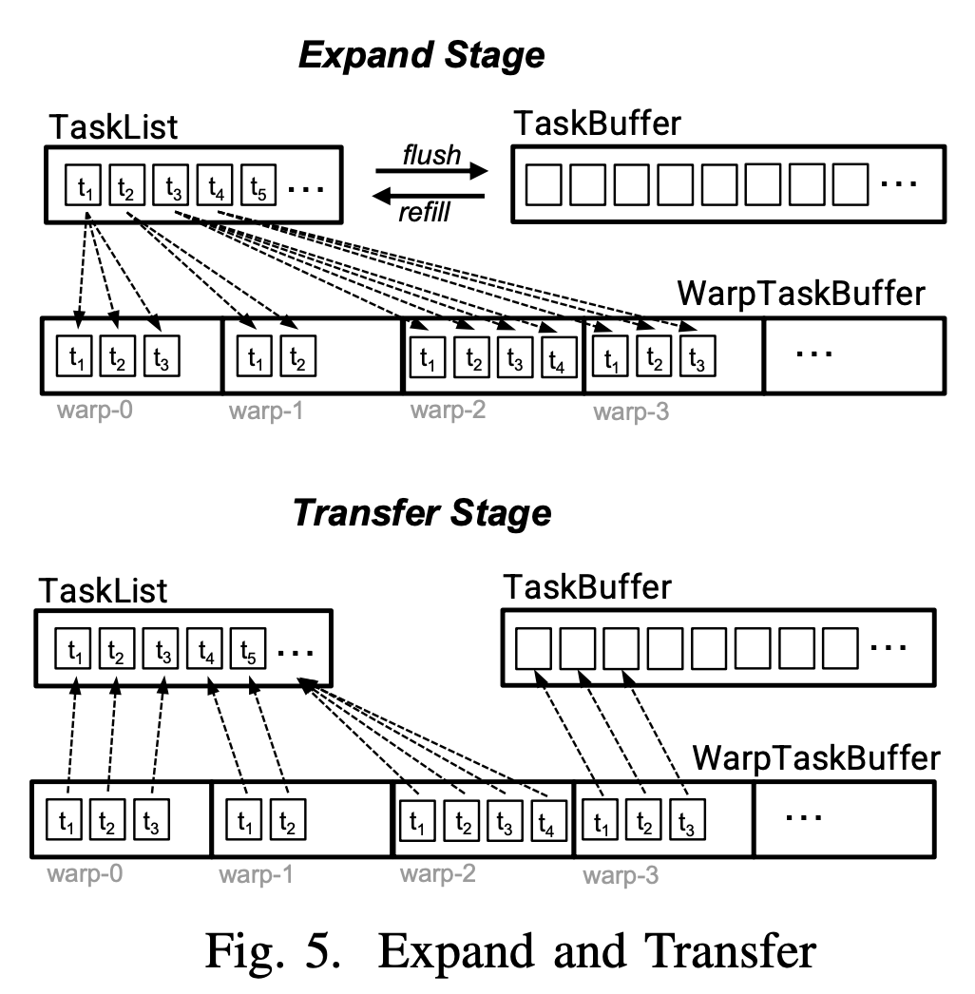
Quasi Clique Application

Slide 5
Results
dataset | V | E | θ | γ | #MQC | Gthinker-CG | DCFastQC | Quick+ | cu-QC | #{cu-QC}
ca-GrQc | 26,198 | 14,490 | 10 | 0.9 | 1,665 | 0.1 | 0.1 | 0.4 | 1.3 | 19
condmat-dimacs | 39,577 | 175,691 | 10 | 0.9 | 7,222 | 1.2 | 0.2 | 8.2 | 2.2 | 432
condmat | 108,301 | 93,468 | 15 | 0.8 | 4,382 | 0.2 | 0.1 | 3.2 | 1.5 | 0, paper reported(4396)
enron | 36,692 | 183,831 | 23 | 0.9 | 200 | 9.7 | 12.8 | 102.0 | 3.3 | 0, paper reported(200)
facebook | 4,039 | 88,234 | 103 | 0.95 | 1 | 104.2 | 282.9 | 352.1 | 1.4 | 0, paper reported (2)

Slide 6
Dividing Tasks Among CPU Workers
Earlier CPU workers takes fixed number of tasks/vertices (cpuchunk)
A better division is:
min(#tasks / #workers, cpuchunk)

Slide 7
Distributing Small No. of Tasks
Ideally, GPU should get large number of initial tasks
If the no. of tasks less, then divide percentage of tasks to GPU

Slide 8
div_factor experiments
Flixster | k=23 | g=0.95
Div_factor | Time(sec)
0.70 | 37.57
0.80 | 29.64
0.90 | 30.75
0.95 | 32.06
1.00 | 101.65

Slide 9
Buffer
offsets
Current
st
md
en
vertices
S
C

Slide 10
Buffer
offsets
Current
st
md
en
vertices
S
C
offsets
Proposed
st
en
vertices
S
C
mid
st

Slide 11
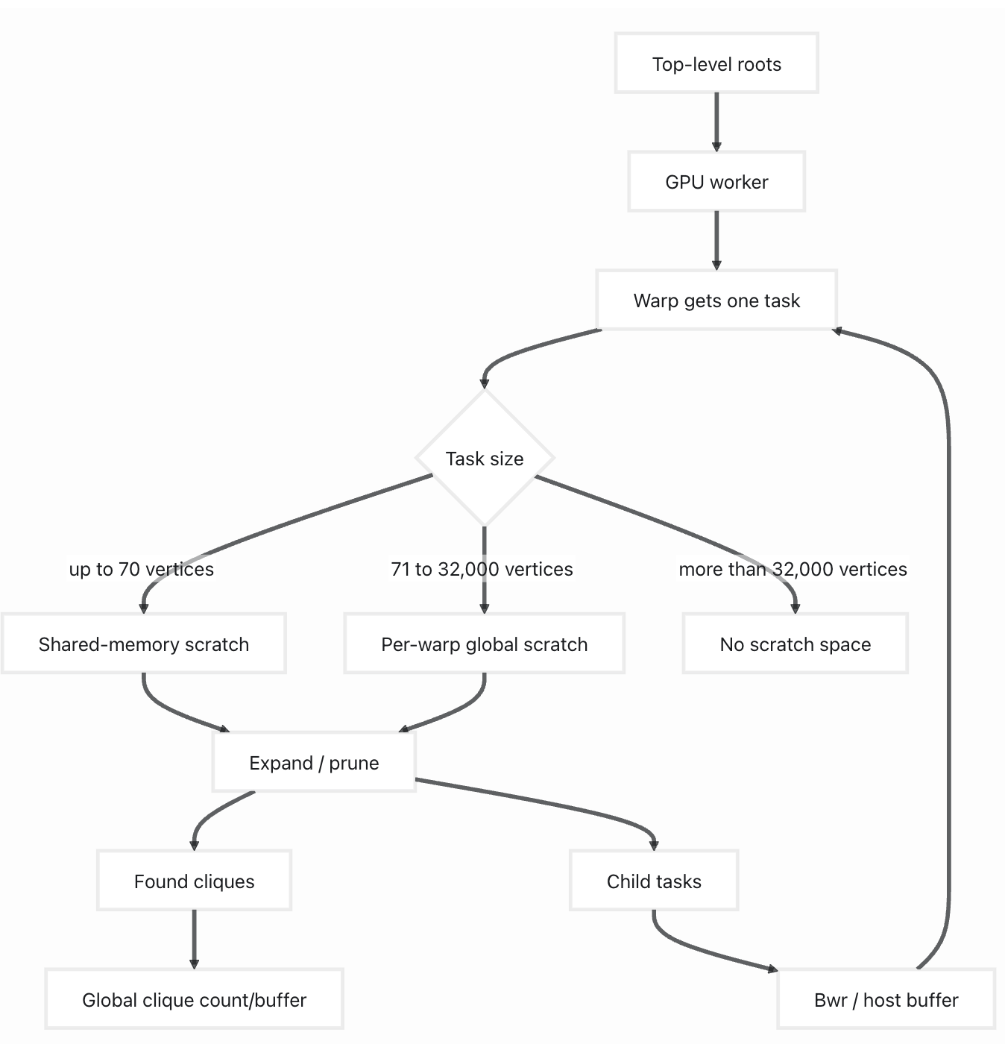
Scratch Buffer
top level tasks
 |  | v
2-hop neigh

Slide 12
Scratch Buffer
top level tasks
 |  | v
2-hop neigh
per warp scratch
with 32000 it sums to 6.5GB

Slide 13
Handlink Big Tasks
root vertices
 |  | v
2-hop neigh
root vertices with big tasks are separated at initialization step, using CPU threads (by OpenMP)
regular root vertices
big_root vertices
master schedules big_root
vertices to CPU threads only

Slide 14

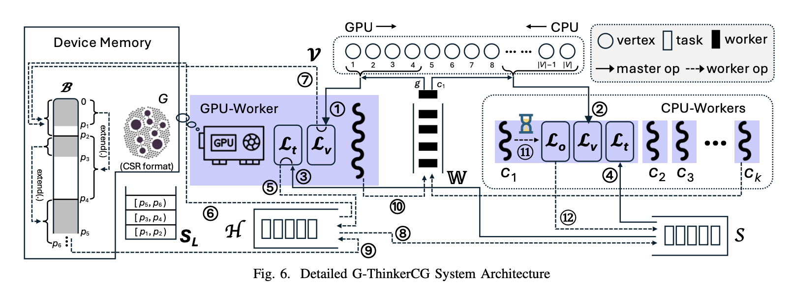
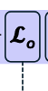

Update CPU Worker
CPU →
big_root
still a
big task
big
big_S

